Slide 1
Artificial intelligence
Autumn 2008
Instructor: Wang Xiaolong
Harbin Institute of Technology, Shenzhen Graduate School
Intelligent Computation Research Center
(HITSGS)

Slide 2
IX. Inference in First-order logic
Autumn 2008
Instructor: Wang Xiaolong
Harbin Institute of Technology, Shenzhen Graduate School
Intelligent Computation Research Center
(HITSGS)

Slide 3
Outline
Reducing first-order inference to propositional inference
Unification
Generalized Modus Ponens
Forward chaining
Backward chaining
Resolution

Slide 4
Universal instantiation (UI)
Every instantiation of a universally quantified sentence is entailed by it:
∀v α
Subst({v/g}, α)
for any variable v and ground term g
E.g., ∀x King(x) ∧ Greedy(x) ⇒ Evil(x) yields:
  King(John) ∧ Greedy(John) ⇒ Evil(John)
  King(Richard) ∧ Greedy(Richard) ⇒ Evil(Richard)
  King(Father(John)) ∧ Greedy(Father(John)) ⇒ Evil(Father(John))
  .
  .
  .

Slide 5
Existential instantiation (EI)
For any sentence α, variable v, and constant symbol k that does not appear elsewhere in the knowledge base:
∃v α
Subst({v/k}, α)
E.g., ∃x Crown(x) ∧ OnHead(x,John) yields:
Crown(C₁) ∧ OnHead(C₁,John)
provided C₁ is a new constant symbol, called a Skolem constant

Slide 6
Reduction to propositional inference
Suppose the KB contains just the following:
  ∀x King(x) ∧ Greedy(x) ⇒ Evil(x)
  King(John)
  Greedy(John)
  Brother(Richard,John)
Instantiating the universal sentence in all possible ways, we have:
  King(John) ∧ Greedy(John) ⇒ Evil(John)
  King(Richard) ∧ Greedy(Richard) ⇒ Evil(Richard)
  King(John)
  Greedy(John)
  Brother(Richard,John)
The new KB is propositionalized: proposition symbols are
  King(John), Greedy(John), Evil(John), King(Richard), etc.

Slide 7
Reduction contd.
Every FOL KB can be propositionalized so as to preserve entailment
(A ground sentence is entailed by new KB iff entailed by original KB)
Idea: propositionalize KB and query, apply resolution, return result
Problem: with function symbols, there are infinitely many ground terms,
  e.g., Father(Father(Father(John)))

Slide 8
Reduction contd.
Theorem: Herbrand (1930). If a sentence α is entailed by an FOL KB, it is entailed by a finite subset of the propositionalized KB
Idea: For n = 0 to ∞ do
  create a propositional KB by instantiating with depth (n) terms
  see if α is entailed by this KB
Problem: works if α is entailed, loops if α is not entailed
Theorem: Turing (1936), Church (1936) Entailment for FOL is
semidecidable (algorithms exist that say yes to every entailed sentence, but no algorithm exists that also says no to every nonentailed sentence.)

Slide 9
Problems with propositionalization
Propositionalization seems to generate lots of irrelevant sentences.
E.g., from:
  ∀x King(x) ∧ Greedy(x) ⇒ Evil(x)
  King(John)
  ∀y Greedy(y)
  Brother(Richard,John)
it seems obvious that Evil(John), but propositionalization produces lots of facts such as Greedy(Richard) that are irrelevant
With p k-ary predicates and n constants, there are p·n^{k} instantiations.

Slide 10
Unification
We can get the inference immediately if we can find a substitution θ such that King(x) and Greedy(x) match King(John) and Greedy(y)
θ = {x/John,y/John} works
Unify(p , q) = θ if Subst (θ, p) = Subst (θ, q)
p q θ
Knows(John,x) Knows(John,Jane)
Knows(John,x) Knows(y,OJ)
Knows(John,x) Knows(y,Mother(y))
Knows(John,x) Knows(x,OJ)

Slide 11
Unification
We can get the inference immediately if we can find a substitution θ such that King(x) and Greedy(x) match King(John) and Greedy(y)
θ = {x/John,y/John} works
Unify(p , q) = θ if Subst (θ, p) = Subst (θ, q)
p q θ
Knows(John,x) Knows(John,Jane) {x/Jane}
Knows(John,x) Knows(y,OJ)
Knows(John,x) Knows(y,Mother(y))
Knows(John,x) Knows(x,OJ)

Slide 12
Unification
We can get the inference immediately if we can find a substitution θ such that King(x) and Greedy(x) match King(John) and Greedy(y)
θ = {x/John,y/John} works
Unify(p , q) = θ if Subst (θ, p) = Subst (θ, q)
p q θ
Knows(John,x) Knows(John,Jane) {x/Jane}
Knows(John,x) Knows(y,OJ) {x/OJ,y/John}
Knows(John,x) Knows(y,Mother(y))
Knows(John,x) Knows(x,OJ)

Slide 13
Unification
We can get the inference immediately if we can find a substitution θ such that King(x) and Greedy(x) match King(John) and Greedy(y)
θ = {x/John,y/John} works
Unify(p , q) = θ if Subst (θ, p) = Subst (θ, q)
p q θ
Knows(John,x) Knows(John,Jane) {x/Jane}
Knows(John,x) Knows(y,OJ) {x/OJ,y/John}
Knows(John,x) Knows(y,Mother(y)) {y/John,x/Mother(John)}
Knows(John,x) Knows(x,OJ)

Slide 14
Unification
We can get the inference immediately if we can find a substitution θ such that King(x) and Greedy(x) match King(John) and Greedy(y)
θ = {x/John,y/John} works
Unify(p , q) = θ if Subst (θ, p) = Subst (θ, q)
p q θ
Knows(John,x) Knows(John,Jane) {x/Jane}
Knows(John,x) Knows(y,OJ) {x/OJ,y/John}
Knows(John,x) Knows(y,Mother(y)) {y/John,x/Mother(John)}
Knows(John,x) Knows(x,OJ) {fail}
Standardizing apart eliminates overlap of variables, e.g., Knows(z₁₇,OJ)

Slide 15
Unification
To unify Knows(John,x) and Knows(y,z),
θ = {y/John, x/z } or θ = {y/John, x/John, z/John}
The first unifier is more general than the second.
There is a single most general unifier (MGU) that is unique up to renaming of variables.
  MGU = { y/John, x/z }

Slide 16
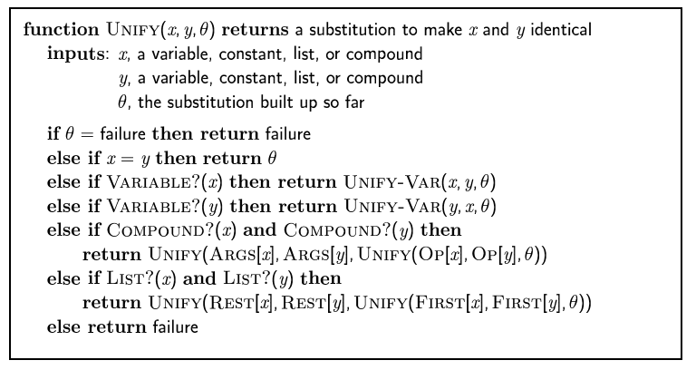
The unification algorithm

Slide 17
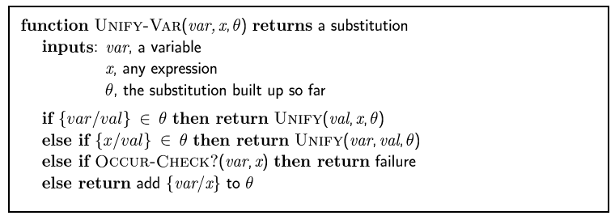
The unification algorithm

Slide 18
Generalized Modus Ponens (GMP)
p₁', p₂', … , p_{n}', ( p₁ ∧ p₂ ∧ … ∧ p_{n} ⇒q)
Subst (θ,q)
p₁' is King(John) p₁ is King(x)
p₂' is Greedy(y) p₂ is Greedy(x)
θ is {x/John,y/John} q is Evil(x)
Subst (θ,q) is Evil(John)
GMP used with KB of definite clauses (exactly one positive literal)
All variables assumed universally quantified
where Subst (θ ,p_{i}‘) = Subst (θ ,p_{i}) for all i

Slide 19
Soundness of GMP
Need to show that
p₁', …, p_{n}', (p₁ ∧ … ∧ p_{n} ⇒ q) ╞ Subst (θ,q)
provided that Subst (θ ,pi‘) = Subst (θ ,pi) for all i
Lemma: For any sentence p, we have p ╞ Subst (θ,q) by UI
(p₁ ∧ … ∧ p_{n} ⇒ q) ╞ Subst(θ,(p₁ ∧ … ∧ p_{n} ⇒ q)) = (Subst(θ ,p₁) ∧ … ∧ Subst(θ ,p_{n}) ⇒ Subst(θ ,q))
p₁', …, p_{n}' ╞ p₁' ∧ … ∧ p_{n}' ╞ Subst(θ,p₁') ∧ … ∧ Subst(θ,p_{n}')
From 1 and 2, Subst(θ ,q) follows by ordinary Modus Ponens

Slide 20
FOL definite clauses
Disjunctions of literals of which exactly one is positive.
A definite clause either is atomic or is an implication whose antecedent is a conjunction of positive literals and whose consequent is a single positive literal.
Eg. King(x) ∧ Greedy(x) ⇒ Evil(x)
King(John)
Greedy(y)
Unlike propositional literals, FOL literals can include variables (universally quantified).
Not every KB can be converted into a set of definite clauses. But many can.

Slide 21
Example knowledge base
The law says that it is a crime for an American to sell weapons to hostile nations. The country Nono, an enemy of America, has some missiles, and all of its missiles were sold to it by Colonel West, who is American.
Prove that Col. West is a criminal.

Slide 22
Example knowledge base contd.
... it is a crime for an American to sell weapons to hostile nations:
  American(x) ∧ Weapon(y) ∧ Sells(x,y,z) ∧ Hostile(z) ⇒ Criminal(x)
Nono … has some missiles, i.e., ∃x Owns(Nono,x) ∧ Missile(x):
  Owns(Nono,M₁)
  Missile(M₁)
… all of its missiles were sold to it by Colonel West
  Missile(x) ∧ Owns(Nono,x) ⇒ Sells(West,x,Nono)
Missiles are weapons:
  Missile(x) ⇒ Weapon(x)
An enemy of America counts as "hostile“:
  Enemy(x,America) ⇒ Hostile(x)
West, who is American …
  American(West)
The country Nono, an enemy of America …
  Enemy(Nono,America)

Slide 23
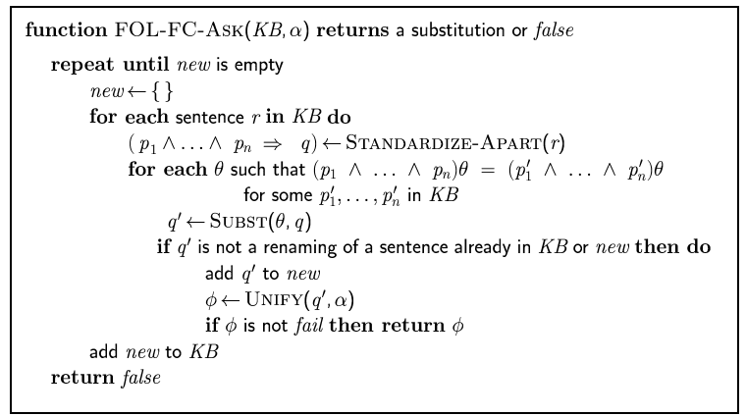
Forward chaining algorithm

Slide 24
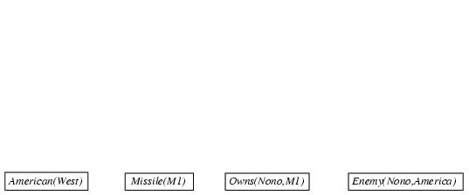
Forward chaining proof

Slide 25
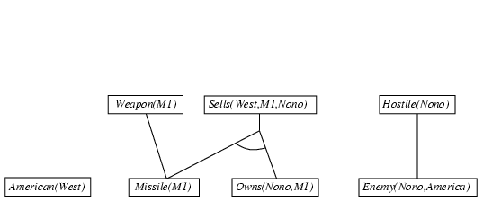
Forward chaining proof
Missile(x) ⇒ Weapon(x)
  Missile(x) ∧ Owns(Nono,x) ⇒ Sells(West,x,Nono)
  Enemy(x,America) ⇒ Hostile(x)

Slide 26
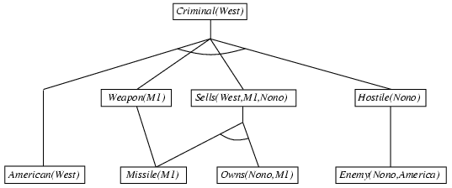
Forward chaining proof
  American(x) ∧ Weapon(y) ∧ Sells(x,y,z) ∧ Hostile(z) ⇒ Criminal(x)

Slide 27
Properties of forward chaining
Sound and complete for first-order definite clauses
Datalog = first-order definite clauses + no functions
FC terminates for Datalog in finite number of iterations
May not terminate in general if α is not entailed
This is unavoidable: entailment with definite clauses is semidecidable

Slide 28
Efficiency of forward chaining
Incremental forward chaining: no need to match a rule on iteration k if a premise wasn't added on iteration k-1
  ⇒ match each rule whose premise contains a newly added positive literal
Forward chaining is widely used in deductive databases

Slide 29

Hard matching example
Diff(wa,nt) ∧ Diff(wa,sa) ∧ Diff(nt,q) ∧ Diff(nt,sa) ∧ Diff(q,nsw) ∧ Diff(q,sa) ∧ Diff(nsw,v) ∧ Diff(nsw,sa) ∧ Diff(v,sa) ⇒ Colorable()
Diff(Red,Blue) Diff (Red,Green) Diff(Green,Red) Diff(Green,Blue) Diff(Blue,Red) Diff(Blue,Green)
Colorable() is inferred iff the CSP has a solution
CSPs include 3SAT as a special case, hence matching is NP-hard
  Note: Reference to: John E. Hopcroft, Rajeev Motwani, Jefferey D. Ullman, “Introduction to automata theory, language, and computation” (2nd), Tsinghua university press, Addison-Wesley.

Slide 30
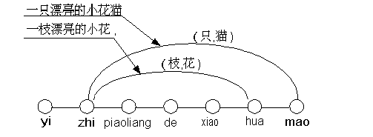
Examples of long distance restriction

Slide 31
In the w-n-gram model, finding character or words corresponding to the speech syllable input
yi(一,疑,以,已,衣,亿,依,易,医,...)
zhi(只,之,直,知,制,指,纸,支,芝,...)
piaoliangde(漂亮的)
xiao(小,笑,消,削,销,萧,效,宵,晓,...)
hua(话,花,化,画,华,划,滑,哗,猾,...)
mao(毛,冒,帽,猫,矛,卯,貌,茂,贸,...).

Slide 32
and the relevant rules
花 → plant
猫 → animal
一 → number
小 → adj
漂亮的 → adj
花 → adj
adj + animal → animal
adj + plant → plant
number+ 只+animal → animal
number+ 枝+plant → plant.

Slide 33
A good example of recursive nature is number. A group of simplified rules for describing Chinese number are given below:
MX={一，二，三，四，五，六，七，八，九}
MX0={零}
MW={十,百,千,万,亿,兆}
MWW={万,亿,兆}
MH={好些, 许多, 若干, 几, 两}
MX->MX0 (r1)
MX0+MX0->MMX (r2)
MX0+MMX->MMX (r3)
MX+MW+MX->MX (r4)
MX+MW+零+MX->MX (r5)
MW+MWW->MW (r6)
MWW->MW (r7)
MX+MW->M (r8)

Slide 34
十+MX->MS (r9)
MS+MWW->M (r10)
MS+MWW+MX->MX (r11)
MX0+点+MX->M (r12)
MX0+点+MMX->M (r13)
MS+点+MX->M (r14)
MS+点+MMX->M (r15)
M+倍->MB (r16)
MX0->M (r17)
MMX->M (r18)
MW->M (r19)
MB->M (r20)
MH->M (r21)
MS->M (r22)

Slide 35
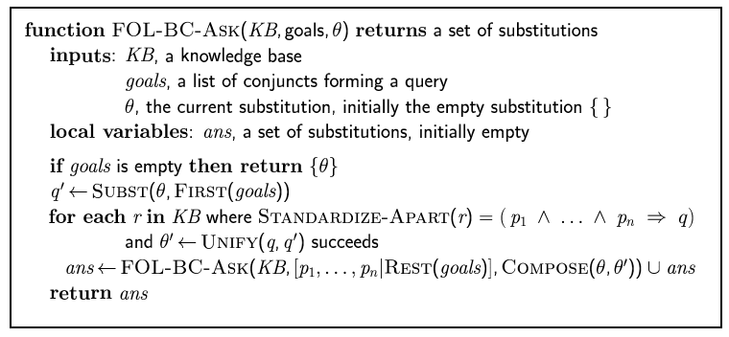
Backward chaining algorithm
SUBST(COMPOSE(θ₁, θ₂), p) = SUBST(θ₂, SUBST(θ₁, p))

Slide 36

Backward chaining example

Slide 37
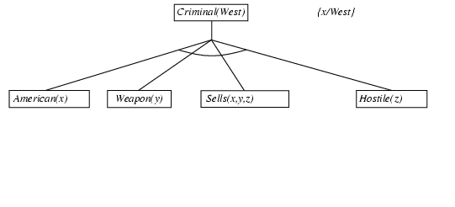
Backward chaining example

Slide 38
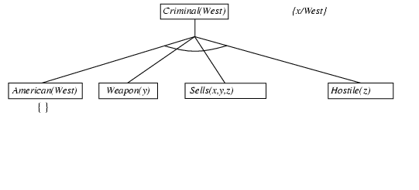
Backward chaining example

Slide 39
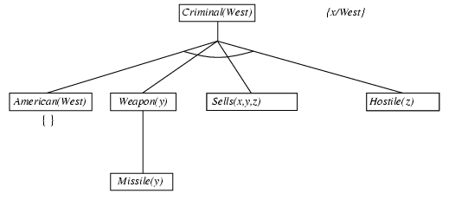
Backward chaining example

Slide 40
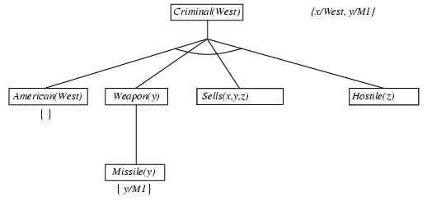
Backward chaining example

Slide 41
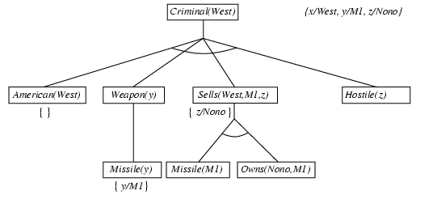
Backward chaining example

Slide 42
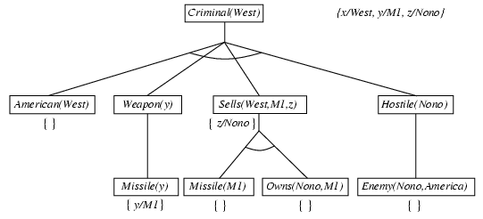
Backward chaining example

Slide 43
Backward chaining example

Slide 44
Properties of backward chaining
Depth-first recursive proof search: space is linear in size of proof
Incomplete due to infinite loops
  ⇒ fix by checking current goal against every goal on stack
Inefficient due to repeated subgoals (both success and failure)
  ⇒ fix using caching of previous results (extra space)
Widely used for logic programming

Slide 45
Logic programming: Prolog
Algorithm = Logic + Control
Program = set of clauses = head :- literal₁, … literal_{n}.
criminal(X) :- american(X), weapon(Y), sells(X,Y,Z), hostile(Z).
Depth-first, left-to-right backward chaining
A set of built-in functions for arithmetic etc., e.g., X is Y*Z+3
Built-in predicates that have side effects (e.g., input and output
predicates, assert/retract predicates)
Closed-world assumption ("negation as failure")
  e.g., given alive(X) :- not dead(X).
  alive(joe) succeeds if dead(joe) fails

Slide 46
Prolog
Appending two lists to produce a third:
append([],Y,Y).
append([X|L],Y,[X|Z]) :- append(L,Y,Z).
query: append(A,B,[1,2]) ?
answers: A=[] B=[1,2]
A=[1] B=[2]
A=[1,2] B=[]

Slide 47
Resolution: brief summary
Full first-order version:
l₁ ∨ ··· ∨ l_{k}, m₁ ∨ ··· ∨ m_{n}
Subst(θ, l₁ ∨ ··· ∨ l_{i-1} ∨ l_{i+1} ∨ ··· ∨ l_{k} ∨ m₁ ∨ ··· ∨ m_{j-1} ∨ m_{j+1} ∨ ··· ∨ m_{n})
where Unify(l_{i}, ¬m_{j}) = θ.
The two clauses are assumed to be standardized apart so that they share no variables.
For example,
¬Rich(x) ∨ Unhappy(x)
Rich(Ken)
Unhappy(Ken)
with θ = {x/Ken}
Apply resolution steps to CNF(KB ∧ ¬α); complete for FOL

Slide 48
Conversion to CNF
Everyone who loves all animals is loved by someone:
  ∀x [∀y Animal(y) ⇒ Loves(x,y)] ⇒ [∃y Loves(y,x)]
1. Eliminate biconditionals and implications
  ∀x [¬∀y ¬Animal(y) ∨ Loves(x,y)] ∨ [∃y Loves(y,x)]
2. Move ¬ inwards: ¬∀x p ≡ ∃x ¬p, ¬ ∃x p ≡ ∀x ¬p
  ∀x [∃y ¬(¬Animal(y) ∨ Loves(x,y))] ∨ [∃y Loves(y,x)]
  ∀x [∃y ¬¬Animal(y) ∧ ¬Loves(x,y)] ∨ [∃y Loves(y,x)]
  ∀x [∃y Animal(y) ∧ ¬Loves(x,y)] ∨ [∃y Loves(y,x)]

Slide 49
Conversion to CNF contd.
Standardize variables: each quantifier should use a different one
  ∀x [∃y Animal(y) ∧ ¬Loves(x,y)] ∨ [∃z Loves(z,x)]
Skolemize: a more general form of existential instantiation.
  Each existential variable is replaced by a Skolem function of the enclosing universally quantified variables:
  ∀x [Animal(F(x)) ∧ ¬Loves(x,F(x))] ∨ Loves(G(x),x)
Drop universal quantifiers:
  [Animal(F(x)) ∧ ¬Loves(x,F(x))] ∨ Loves(G(x),x)
Distribute ∨ over ∧ :
  [Animal(F(x)) ∨ Loves(G(x),x)] ∧ [¬Loves(x,F(x)) ∨ Loves(G(x),x)]

Slide 50
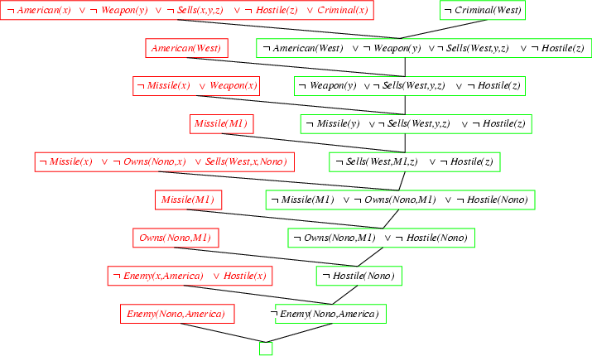
Resolution proof: definite clauses

Slide 51
Resolution proof example 2
The problem is:
Everyone who loves all animals is loved by someone.
Anyone who kills an animal is loved by no one.
Jack loves all animals.
Either Jack or Curiosity killed the cat, who is named Tuna.
Did Curiosity kill the cat?

Slide 52
Resolution proof example 2 contd.
First, we express the original sentences, some background knowledge, and the negated goal G in FOL:
A. ∀x [∀y Animal(y) ⇒ Loves(x,y)] ⇒ [∃y Loves(y,x)]
B. ∀x [∃y Animal(y) ∧kills(x,y)] ⇒[∀z ¬Loves(z,x)]
C. ∀x Animal(x) ⇒ Loves(Jack,x)
D. kills(Jack,Tuna) ∨ kills(Curiosity,Tuna)
E. Cat(Tuna)
F. ∀x Cat(x) ⇒ Animal(x)
¬G. ¬ kills(Curiosity,Tuna)

Slide 53
Resolution proof example 2 contd.
Second, convert each sentence to CNF
A1. Animal(F(x)) ∨ Loves(G(x),x)
A2. ¬Loves(x,F(x)) ∨ Loves(G(x),x)
B. ¬ Animal(y) ∨ ¬ kills(x,y) ∨ ¬ Loves(z,x)
C. ¬ Animal(x) ∨ Loves(Jack,x)
D. kills(Jack,Tuna) ∨ kills(Curiosity,Tuna)
E. Cat(Tuna)
F. ¬ Cat(x) ∨ Animal(x)
¬G. ¬ kills(Curiosity,Tuna)

Slide 54
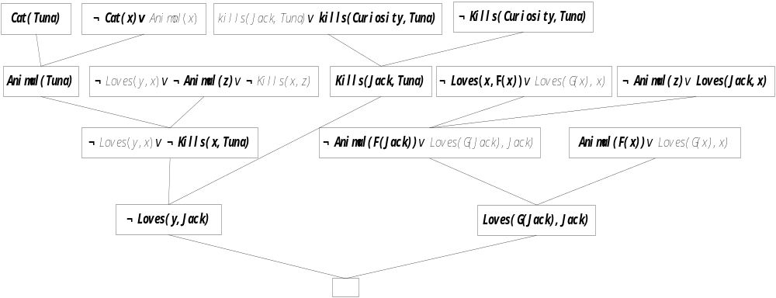
Resolution proof example 2 contd.
The resolution proof that Curiosity killed the cat is given below.

Slide 55
Assignments
Ex 9.11

